Slide 1
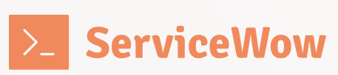
Sovereign Bank
Group 7 – Now Architects
ServiceWow
Notes:
Hello, my name is Pedro Leite, it’s a pleasure to be here representing ServiceWow, bringing solutions for all the challenges that Sovereign Bank might face with ServiceNow.

Slide 2





Meet our team
Eric Jehl
Marta Hernandez
Solution Architect
Senior Technical Consultant
Pedro Leite
Rajesh Kumar
Solution Architect
Principal Software Engineer
Suzi Matsui
Vaibhav Maheshwari
Lead Technical Architect
Senior Software Engineer
Notes:
These are the other members of ServiceWow, you will have the pleasure of meeting them all in the next couple of weeks

Slide 3

Strengths
Experience
Multi-Language capabilities
>40 years
EN, HI, ES, FR, PT
Certificates
Experts
ITSM, IRM, SecOps, SPM, Integrations, CSM, FSM, HR, SAM, APM
>20
Clients background
Public System, Bank, Services, Food industry, HealthCare, Pharma, Retail
Notes:
We have more than 40 years combine of experience
We are a multi-language team
We have more than 20 certificates combined in many different modules
Such as ITSM, IRM, SecOps, SPM, Integrations, CSM, FSM, ITSM, HR, SAM
And we worked with clients from multiple backgrounds such as....

Slide 4






Anticipated Challenges
Regulatory Compliance
Data Security and Privacy
Integration
Data Migration and Integrity
Organizational Change Management
Complexity and Scale
Notes:
Regulatory Compliance
Data Security and Privacy
Integration
Data Migration and Integrity
Organizational Change Management
Complexity and Scale

Slide 5

Regulatory Compliance
Compliance with all relevant regulations (e.g. GDPR, PCI, CSS)
Using risk assessment tools to manage compliance risks
Implement Role based access controls
Notes:
(Introductory topic text)
Regulatory compliance is crucial for banks as it ensures they operate within legal frameworks,
avoid financial penalties,
maintain customer trust,
and protect the integrity of the financial system.
(Bullet points on the slide)
We can achieve that by offering the possibility of Compliance with all relevant regulations (e.g. GDPR, PCI, CSS) in the same platform.
We can also use risk assessment tools to manage compliance risks
And with the implementation of role-based access controls,
we can prevent users or groups from accessing sensitive data.

Slide 6

Data Security and Privacy
Role-Based Access Controls limit sensitive data access to authorized personnel.
Field Level Encryption for storing Sensitive Data
Multi-Factor Authentication and Single Sign-on
Notes:
(Introductory topic text)
To safeguard Personally Identifiable Information such as Social Security Numbers,
financial transactions,
and HR data,
Sovereign Bank must navigate cross-border data sharing restrictions imposed by government regulatory compliance
while mitigating cybersecurity risks across its on-premise, hybrid, and cloud environments.
(Bullet points on the slide)
Our company can reinforce security by enforcing Role-Based Access Controls, ensuring only authorized people access sensitive information.
Use Field-Level Encryption to protects critical data while maintaining usability,
and Multi-Factor Authentication with Single Sign-On to enhance secure access across systems.
Also, Data in the development instances must be anonymized so they wont be exposed.
These capabilities help Sovereign Bank mitigate risks and maintain security.

Slide 7

Integration
Enforce OAuth 2.0 or mutual authentication
MID Servers for secure integrations
Integration by Email, Webservice, FTPs, JDBC
Notes:
(Introductory topic text)
Sovereign Bank can utilize ServiceNow third party system integration capabilities while navigating firewall restrictions,
security constraints,
and authentication challenges.
(Bullet points on the slide)
Our team can simplify integrations security by enforcing OAuth 2.0 or mutual authentication for secure communication,
It can use MID Servers to enable secure on-premise connectivity
A MID Server securely connects ServiceNow with external systems, enabling smooth data flow without exposing sensitive information.
The platform allows multiple ways of integrating with it such as by Email, Webservice (REST and SOAP), FTPs, JDBC.
These solutions ensure interoperability while maintaining compliance and security.

Slide 8
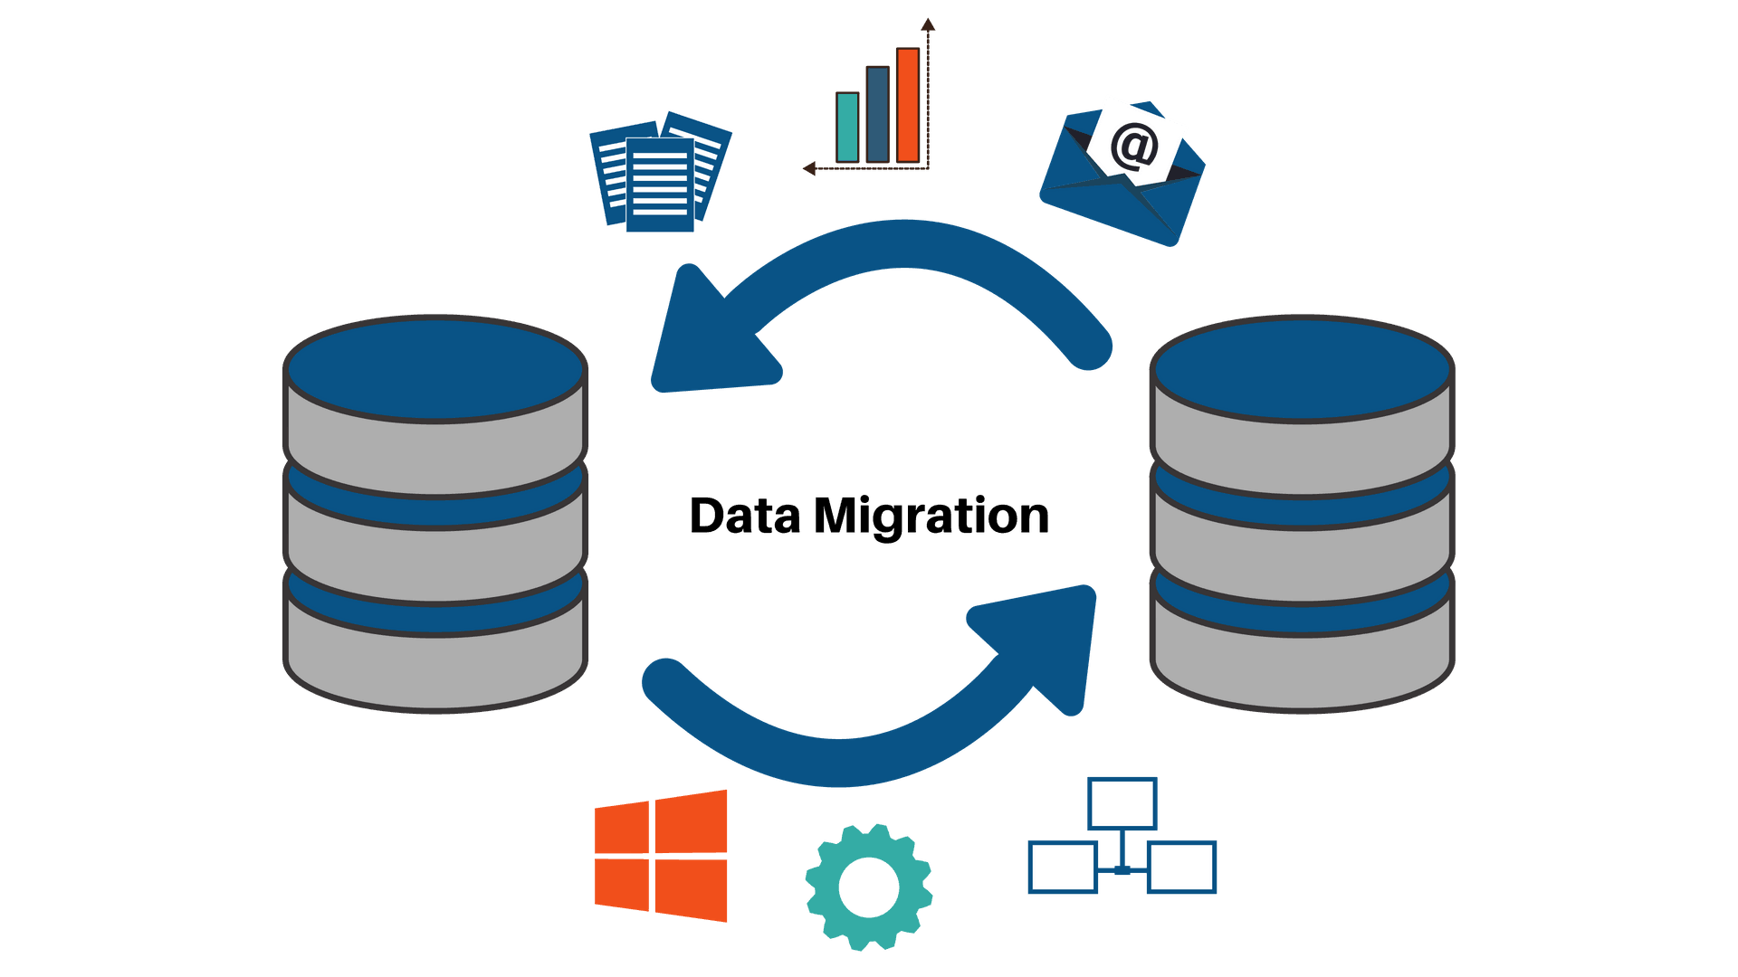
Data Migration and Integrity
Use of IntegrationHub spokes to import data form Remedy
For CMDB, sanitize the data using Identification and Reconciliation Engine
ServiceNow provides tools like Data Certification for data quality assessment and cleansing
Notes:
(Introductory topic text) Sovereign Bank must consolidate and validate data from legacy systems
to ensure accuracy and prevent loss during migration to ServiceNow.
(Bullet points on the slide)
To successfully achieve, while preventing data loss, we can use IntegrationHub spokes to import data from Remedy,
for CMDB, data can be sanitized using Identification and Reconciliation Engine.
To maintain data quality, we can use ServiceNow tools like Data Certification for data quality assessment and cleansing

Slide 9

Organizational Change Management
Guided Tours and self-service training ease the transition
Collaboration tools and stakeholder engagement promote transparency
Automated workflows free up employees for higher-value work
Knowledge Articles/Base creation, surveys
Notes:
(Introductory topic text)
To drive successful adoption of ServiceNow,
Sovereign Bank must address resistance to process changes from long-tenured employees,
align conflicting priorities across business units,
and mitigate fears of job losses due to automation through clear communication and change management strategies.
(Bullet points on the slide)
Guided Tours and self-service training will ease adoption,
while Knowledge Articles and surveys empower users and gather feedback.
Within the platform, we can promote transparency through collaboration tools and stakeholder engagement, ensuring alignment across teams.
Automated workflows reduce manual tasks, allowing employees to focus on higher-value work.
By leveraging these features, Sovereign Bank can drive a smooth and efficient transition.

Slide 10
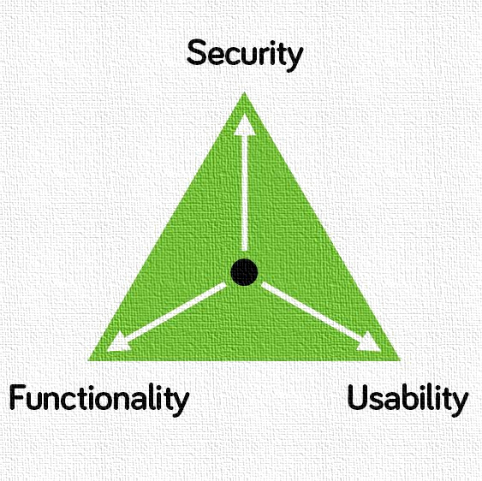
Complexity and Scale
Modular implementation allows phased implementation approach
Performance optimization tools
Scalable Architecture that supports large organizations
Notes:
(Introductory topic text)
Sovereign Bank’s large workforce, global operations, and diverse IT policies make ITSM standardization and performance scalability challenging.
(Bullet points on the slide)
Our team addresses these challenges with a modular implementation approach for phased rollouts,
We can use core performance optimization tools to handle high data volumes,
and a scalable architecture that supports large enterprises, ensuring long-term efficiency and growth.

Slide 11




Thank you
Group 7 – Now Architects
Notes:
Thank you for choosing ServiceWow as your trusted partner in implementing ServiceNow.
It's normal for users to face difficulties and resist change initially, but rest assured, this shift is for the betterment of your company.
Our goal is to ensure a smooth transition from Remedy to ServiceNow, minimizing disruption, overcoming challenges, and optimizing your workflows.
We’re here to support you every step of the way!

